Slide 1
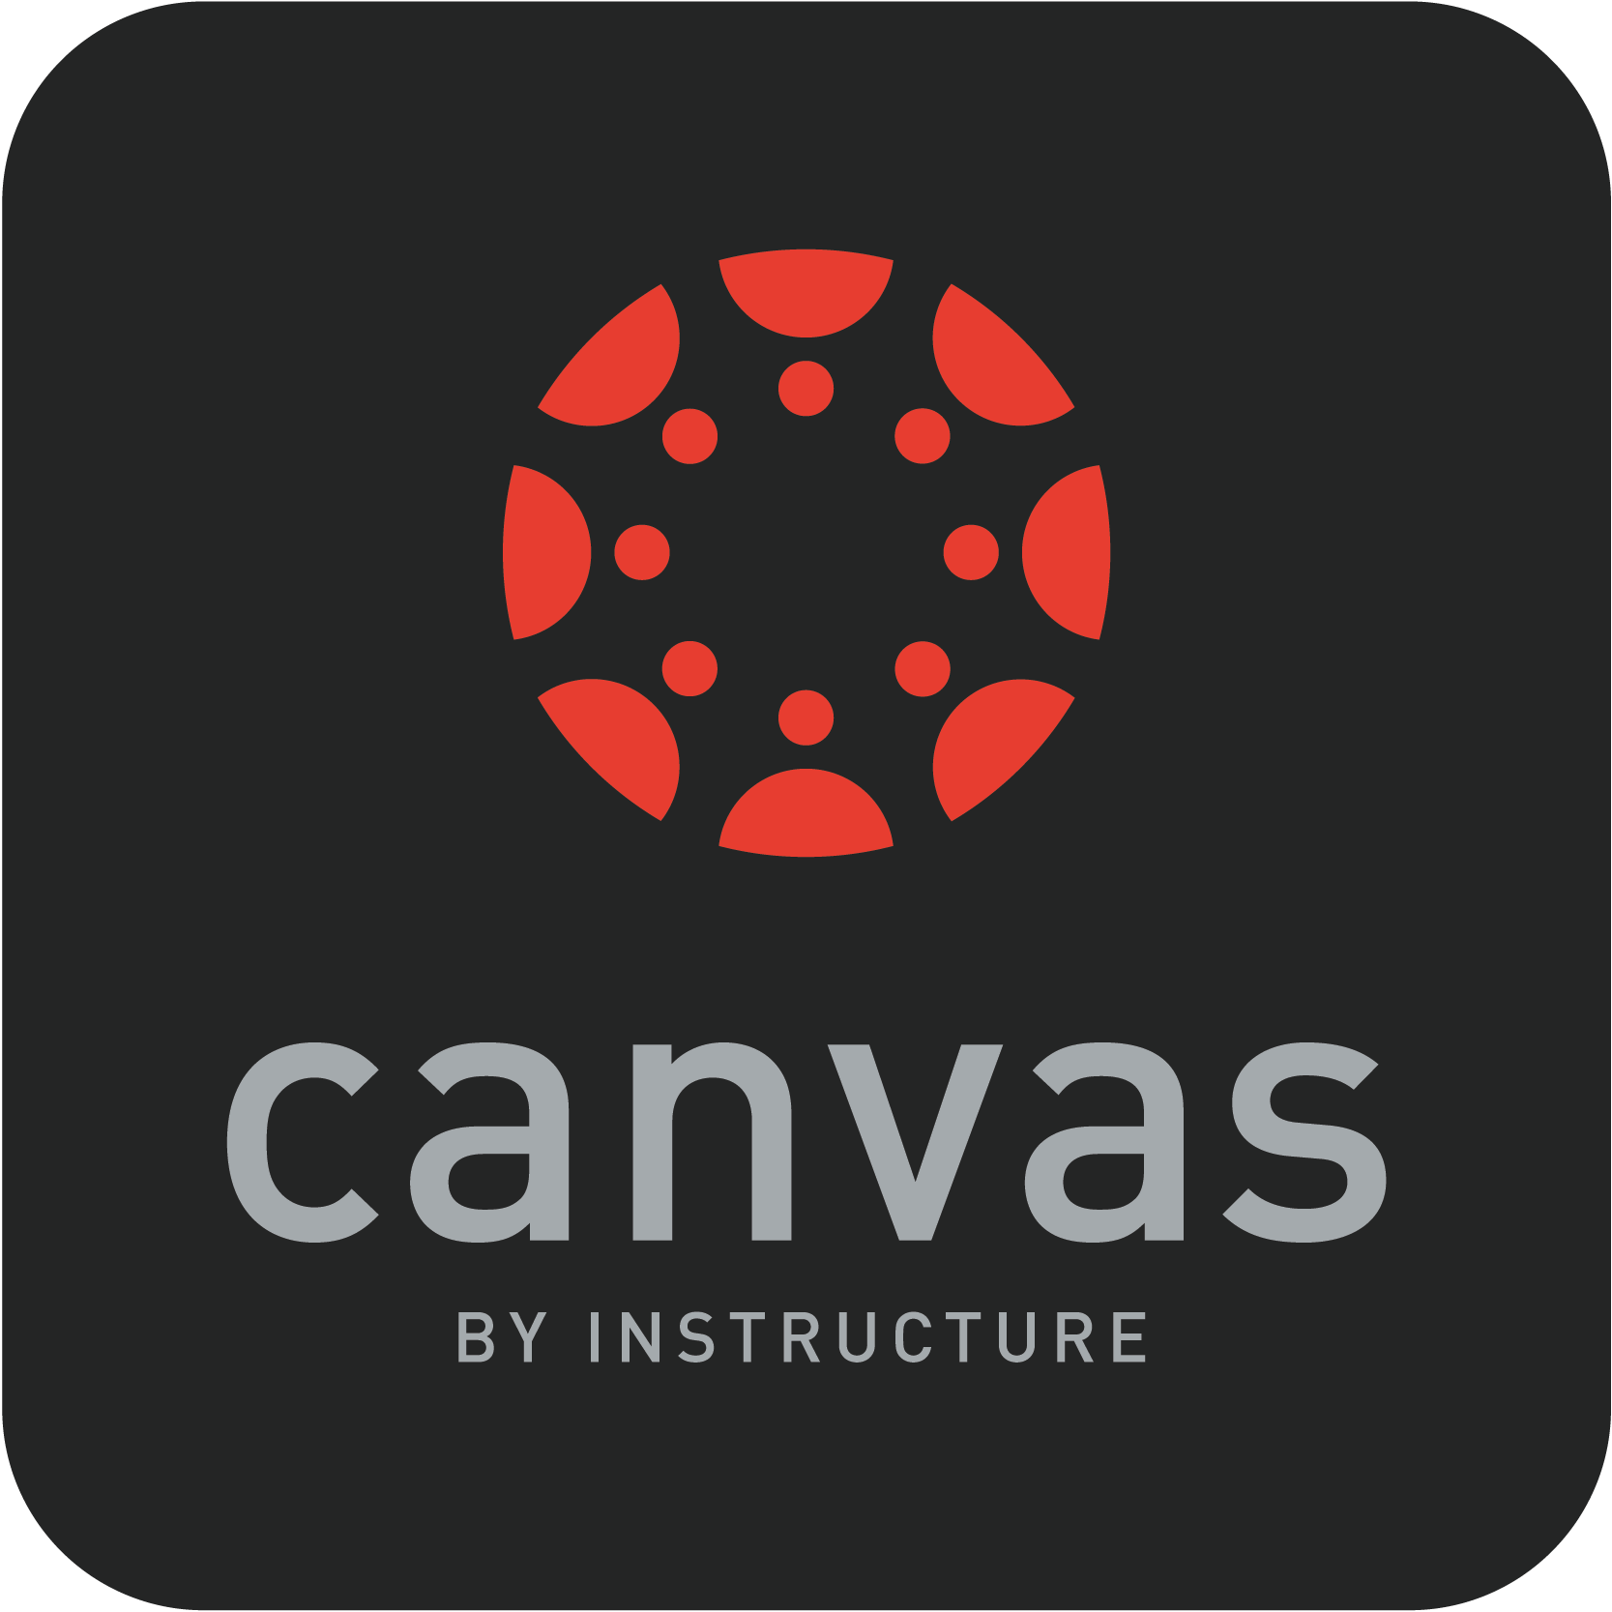

Slide 2
What is canvas?
a Learning Management System (LMS)
an application for the administration, documentation, tracking, reporting, automation and delivery of educational courses for teaching and learning

Slide 3
Why Canvas? Why now?
Because of the precedence that has now been set due to COVID-19 and the ever-growing role online learning has in our world, Cobb County Schools just can’t afford not to have a good LMS in place.
Students and parents get very frustrated when each of their teachers are using different digital tools for learning. Students need something cohesive and easy to use so that they can focus on what really matters: learning.
It takes time to train people to properly use an LMS, so swift implementation is very important.

Slide 4
Our Vision:
Preparing digital-age learners for success in a global, ever-changing society.
Goals:
Leverage technology to transform traditional classrooms into digital age classrooms.
Create and support effective and ethical digital age learning environments.
Empower digital-age learners, teachers, and administrators to use technology tools to enhance rigorous, relevant, and engaging learning experiences.
CCSD
Instructional
Technology
Vision
Notes:
Illustration from www.freepik.com | Designed by slidesgo

Slide 5
Canvas is a practical solution
Digital literacy
Digital age classrooms
Engagement
Differentiation
Notes:
Digital literacy An LMS like Canvas reduces frustration and empowers students and their families in a way that they are familiar with.
Digital age classrooms Canvas is arguably the leading LMS in K-12 and Higher Education Institutions.
Engagement Canvas will reduce frustration and interfaces well with a multitude of different resources.
Differentiation Canvas allows teachers to differentiate without the stigma. It can be adapted to each student and their personalized learning needs.

Slide 6
Check out the following video!
Notes:
https://www.youtube.com/watch?time_continue=3&v=TdDS6gVdI10&feature=emb_logo

Slide 7
Technical Support is available 24/7
Through Canvas’ Global Navigation Menu. The canvas website includes many troubleshooting guides.
Canvas can be used in
both K-12
Environments and Higher Institutions. Canvas is the second most used educational LMS.
Equipment Required:
Internet Access
Desktop Computer, tablet, laptop, or phone
Virtually accessible anywhere!

Slide 8
Central Communication Hub
Personalized Learning
Built-In Accessibility Features
Ease-of-Use
Security
Branching for Differentiation
Notes:
Teachers have their email, gradebook, attendance records, calendar, and assignment accessible all on the same page.
Canvas makes communicating with Parents and Students a snap.
Security – Student data stays private.
Illustration from www.freepik.com | Designed by Freepik

Slide 9
Canvas has integrated live video conference capabilities .
Students can join class discussions and be required to give feedback via peer reviews.
Shared calendars help parents, students, and teachers stay organized and on the same page.

Slide 10
Pricing for CCSD:
Canvas starts at $10 per student per month with discounts available for larger systems.
Funding:
Qbe money allotted for student technology
Notes:
Illustration from www.freepik.com | Designed by Freepik

Slide 11
Limitations
Just as in any school system, we are aware that there will be Cobb County students who do not own the required devices or have internet access needed to be successfully involved in remote learning.
Fortunately, CCSD is equipped to provide laptops and hotspots for those students in need when necessary.
There could also be limitations of integrating pre-existing digital tools into the canvas platform; however, the Canvas platform is constantly being innovated upon to stay abreast of these issues.

Slide 12
Authenticity
Canvas is authentic because it utilizes tools and systems that students and their families are already familiar with.
Canvas integrates well with applications students already use.
Canvas can be adapted to students’ personalized learning styles.
Canvas makes accessibility features and foreign language support simple to use.

Slide 13
Research-based evidence
The Canvas website is full of evidence proving the success of the product, including testimonials from students and educators around the world.
Notes:
Photo from Microsoft Office Online

Slide 14
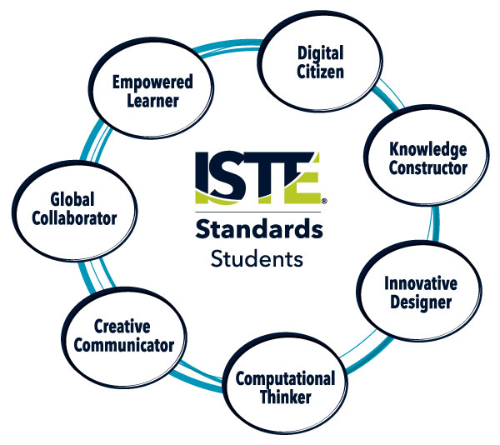
technology standards
Using Canvas would help students meet all seven ISTE standards for students, which is very important to our system.

Slide 15
In Cobb County, we are fortunate to be able to teach and implement digital citizenship skills with our students in a very hands-on way. Canvas supports digital citizenship and the safety of our students with many privacy features and filters. The Canvas website states that they “produce SOC2 Type 2 reports annually to demonstrate Instructure’s compliance with industry best practices for security, availability, confidentiality, processing integrity, and privacy.”
Notes:
Illustration from www.freepik.com | Designed by Euco

Slide 16
Higher-Order Thinking
Canvas has all the tools and resources a teacher would need to effectively design lessons to support higher-order thinking. Canvas has course analytics built in that provide in-depth data that can be used by teachers to empower their lessons. These analytics also support differentiation and personalized learning.
Notes:
Illustration from www.freepik.com | Designed by Freepik

Slide 17
Canvas believes in a holistic approach to professional development. They believe that “professional development is critical for building an equitable foundation of learning.” They offer many options for professional development, including online training, collaborative courses, and in-person workshops, events, and conferences.
Notes:
Illustration from www.freepik.com | Designed by studiogstock

Slide 18
reflection
Researching Canvas, as well as other LMSs out there helped me realize all the benefits a system like Canvas provides, while also shedding light to some of the cons such as pricing. I still feel that Canvas would be a much needed improvement, especially in light of recent situations like Cobb’s response to the COVID-19 disruption. I feel that in this day an age, a system like Canvas is a necessary tool to have in place for digital learning.
The research for the project was educational, yet I feel the strongest aspect of this assignment was to experience the work and energy required to create a like presentation that could be required of effective Instructional Technology coaches. If I was to become an IT for a school system, I feel that this project has much better prepared me to research, present, and possibly implement and LMS.

Slide 19
Sources
Canvas the Learning Management Platform | Instructure [Canvas the Learning Management Platform |
Instructure]. (n.d.). Instructure | Canvas LMS. Retrieved July 13, 2020, from
https://www.instructure.com/canvas/
Welcome | Canvas LMS Community. (n.d.). Canvas LMS Community. Retrieved July 13, 2020, from
https://community.canvaslms.com
Fenton, W. (2017, October 15). Instructure Canvas LMS Review | PCMag. https://www.pcmag.com.
Retrieved July 13, 2020, from https://www.pcmag.com/reviews/instructure-canvas-lms
CanvasLMS. (2015, September 21). The Cool Things You Can Do With Canvas [Video]. YouTube.
https://www.youtube.com/watch?time_continue=3&v=TdDS6gVdI10&feature=emb_logo
NKC Instructional Technology. (2020, March 19). Canvas Live Video Conferencing [Video]. YouTube.
https://www.youtube.com/watch?time_continue=195&v=UjcYwyNkpJY&feature=emb_logo
Blackboard vs. Canvas: Key Features and Services Comparison. (n.d.). BetterBuys. Retrieved July 11,
2020, from https://www.betterbuys.com/lms/blackboard-vs-canvas/

